Slide 1
Welcome Back to Campus
Fall 2020
A Message from the Department of Chemistry to promote safety during COVID-19

Slide 2
We are excited to have you on campus for Fall 2020!
Along with multiple virtual/online courses, the Chemistry Department is offering several in-person courses, including lectures and labs. To promote the safety of our Temple community it is important that everyone follows the COVID-19 safety protocols and procedures.
This presentation will introduce you to the COVID-19 safety procedures and resources available at Temple and those specific to the Chemistry Department.

Slide 5
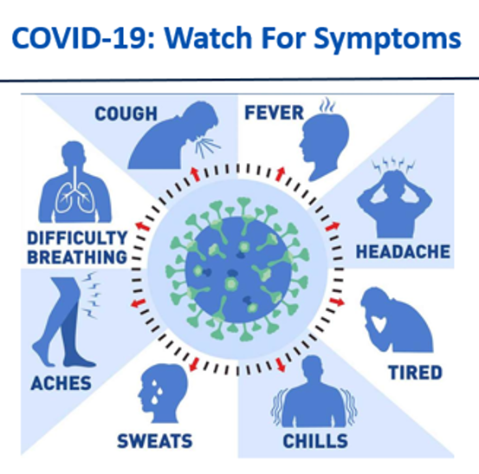
If you experience COVID-19 symptoms, self isolate and do not attend in-person classes.

Slide 6
How do we stay safe?
COVID-19 Health and Safety Plan

Slide 7
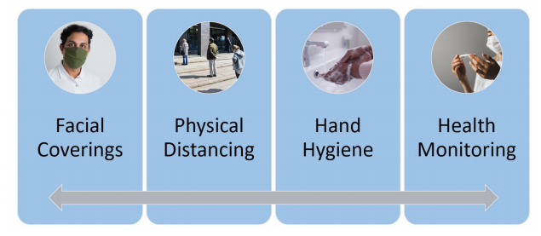
While On Campus: Everyone must
adhere to the
Four Pillars Of Public Safety
Watch this video for more information on the Four Pillars of Public Safety
1. Wearing our face coverings
2. Maintaining physical distancing
3. Washing our hands
4. Monitoring our health

Slide 8
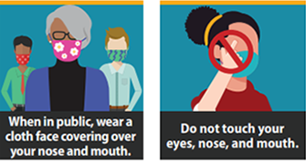
1. Wearing our face coverings
Mask Up Temple

Slide 9
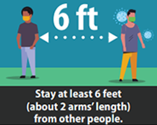
2. Maintaining physical distancing

Slide 10
3. Washing our hands

Slide 11
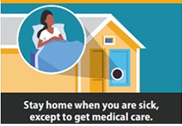
4. Monitoring our health
* Record your temperature daily * Watch out for symptoms of COVID-19

Slide 12
If you experience COVID-19 symptoms, self isolate and do not attend in-person classes. Inform your instructor. For guidance and help, contact TUH COVID-19 triage hotline (215-707-6999)

Slide 13
Safety Directions specific to Beury Hall and the Department of Chemistry:
COVID-19 Health and Safety Plan

Slide 14
What steps have we taken?
Lab spaces have been marked to maintain distancing.
All course enrollments have been decreased to support social distancing.
New PPE requirements for all lab students.
Labeling throughout Beury Hall to maintain safe spaces.

Slide 15
Entering/Exiting Beury Hall
All in/out doors of Beury are designated as Entrances or Exits.
Pay careful attention to signage on doors for traffic pattern instructions.
When entering and exiting the building, keep moving and do not linger around doorways to avoid crowding.

Slide 16
Entering/Exiting Beury Hall
Exit Only
Enter Only
North
Norris Street
Charles Library
Beury
Hall
13th Street
BioLife
Beury Beach

Slide 17
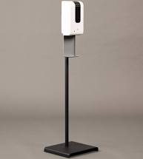
Touchless Hand Sanitizers have been installed in the main Lobby, near all doors, and on all floors.
If a sanitizer is empty, please inform the main office or call 215-204-1385

Slide 18
Pay attention to all traffic pattern directions posted in Beury Hall.

Slide 19
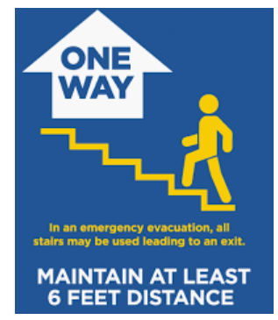
Stairways in Beury Hall are labeled as UP Only or DOWN Only. Pay careful attention to posted signage before entering the stairwells.

Slide 20
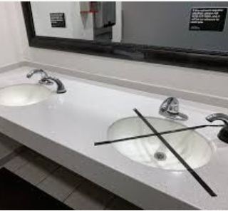
Restrooms are limited to 50% capacity.
Pay attention to signage for maximum occupancy.
Most restrooms have been equipped with foot pulls for handless exiting.

Slide 21
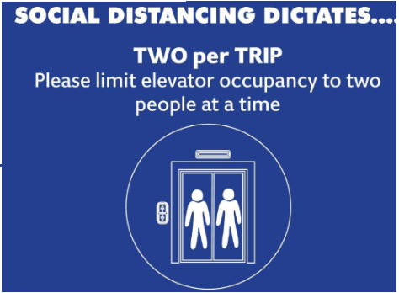
Elevator in Beury Hall:
Maximum occupancy of 2 people at a time.
Please use
the stairs if you are physically able.

Slide 22
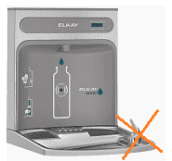
Bubbler-style water fountains are disabled. Bottle filling stations are available with the bubbler portion disabled.

Slide 23
In-Person Courses (Lectures & Labs):
Closely read the directions for all of your in-person courses on Canvas before the course begins!
Reach out to your instructor(s) if you have any questions.

Slide 24
Waiting for your class to start?
Avoid coming to Beury more than 10 minutes before your class is scheduled to begin.
Wait outside of the door until you are instructed to enter.
Maintain 6 feet from other classmates while waiting.
Keep your mask on.

Slide 25
Listen for Instructions:
It is imperative that you listen to and heed any instructions from your professors and TAs.
These instructions are for all of our safety.
If someone asks you to adjust your mask, please do so. Classes can only continue when all safety measures are followed.

Slide 26
Listen for Instructions:
If safety instructions are not followed, the course will be stopped and that day’s lesson will be completed virtually.
We can only maintain in-person instruction when everyone is abiding by the safety protocols.

Slide 27
In-Person Lectures/Recitations:
Maintain social distancing while outside the lecture halls
Pay attention to all “enter” and “exit” signage.
Enter lecture halls from the main doors in the lobby of Beury.
Beury 162, 164, and 166: At the end of class walk to the bottom of the lecture hall to exit.
Beury 160: At the end of class walk to the bottom or back left of the lecture hall to exit.
Only sit in the available seats
There is no eating or drinking inside the lecture halls.

Slide 28
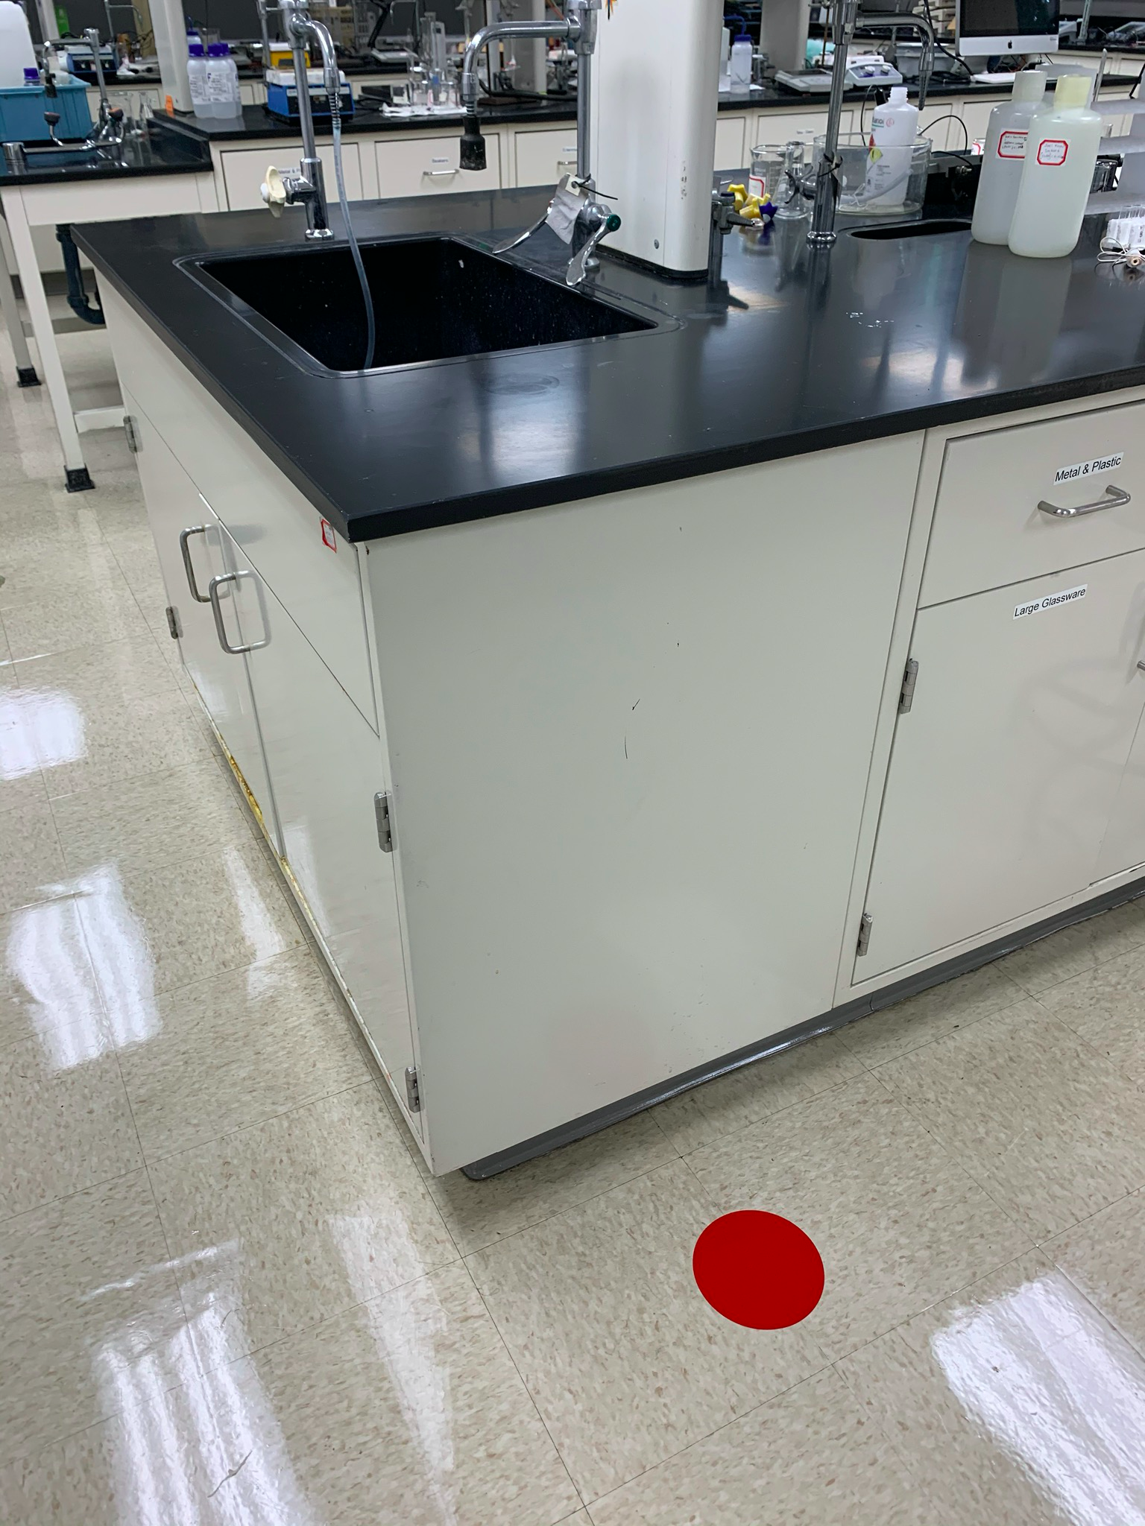
For In-Person Labs:
Follow all floor and bench markings to maintain social distancing.
Be aware of your surroundings:
Pay attention to the location of your classmates as you move around the lab.
Wait at your bench until common areas, like scales and sinks, are open. Avoid forming lines.

Slide 29
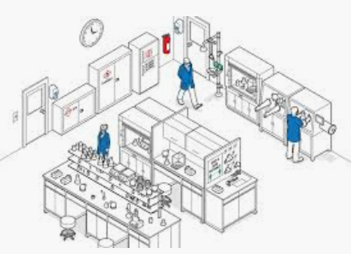
Required PPE for In-Person Labs:
It is your responsibility to have ALL of your PPE for that day’s class. Due to potential contamination, your instructor will not be able to loan you any PPE.
Lab coat (Provided)
Safety Face Shield (Provided)
Goggles (Bring your own)
Face mask (Bring your own)
PPE - Personal Protective Equipment

Slide 30
Required PPE for In-Person Labs:
These items will be given to you:
Lab coat
Keep your lab coat in a sealed bag when not in use. Avoid exposing it to surfaces in your home.
Face Shield
Be careful with your shield! Do not break it!
PPE - Personal Protective Equipment

Slide 31
If we all work together, we can make this semester a success!

Slide 32
What else can you do?
In addition to following all safety guidelines on campus, your choices off-campus greatly affect the continuation of in-person courses:
Avoid large indoor gatherings
Avoid outdoor gatherings where people are not 6 feet apart and masks are not worn
Keep your in-person social circle small

Slide 33
Next Steps?
Log on to Canvas and review any specific safety guidelines for your specific classrooms.
Take the safety quiz (on Canvas) in each of your courses to demonstrate your understanding of the safety guidelines.

Slide 34
While On Campus, check out the following protocols:
Protocol for student safety
Protocol for on-campus university and student events
Protocol for student organization events
Protocol for student fitness and recreation

Slide 35
If you need help:
Technology needs
Health needs
Emotional needs
Food/housing needs

